Slide 1
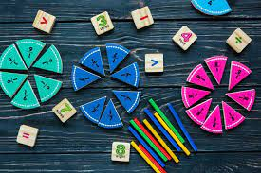
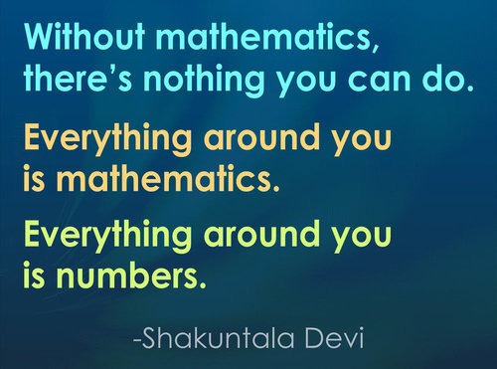
Maths Curriculum Workshop
L Hibell – Tuesday 8th November 2022

Slide 2
Aims
To explain how we teach Maths.
To look at how children progress in Maths across the school.
Understand some of the assessments that children undergo at Primary School.
Look at ways to help our children at home.

Slide 3
How do we teach Mathematics at Barford Primary School?
At Barford Primary we used the White Rose Scheme of Learning. This scheme follows the National Curriculum.
Everyone can do maths: everyone can!

Slide 4
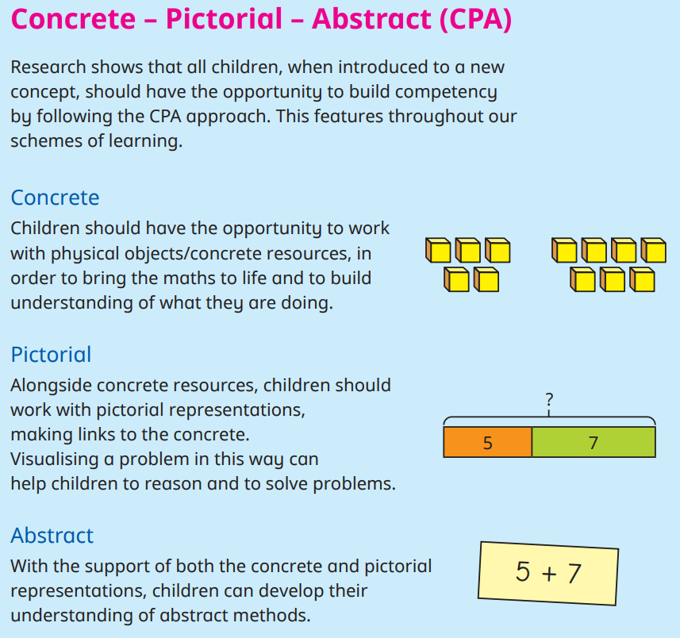
White Rose Maths
White Rose teaches children mathematical concepts through pictorial, practical and written methods in order to develop a deep understanding, confidence and competence in Maths and improve fluency.
White Rose Maths uses the CPA (Concrete, Pictorial, Abstract) approach, which is a highly effective approach to teaching.

Slide 5
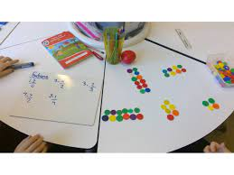
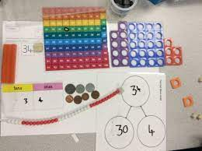
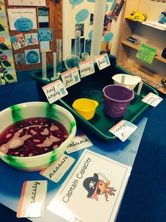
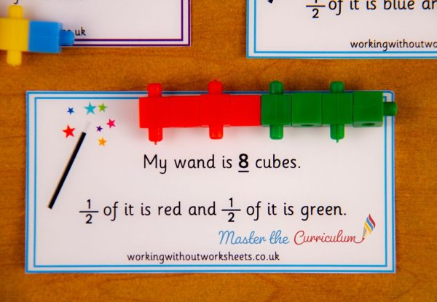
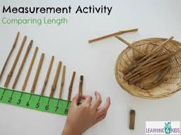
Practical Maths
The children will learn practical ways to understand numbers and easy ways to develop mental maths skills. This includes games, tricks and shortcuts to multiplication, division, addition and subtraction.
Using resources in the classroom to support mathematical understanding.

Slide 6
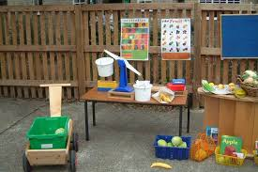
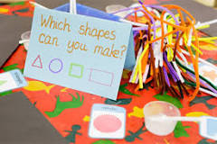
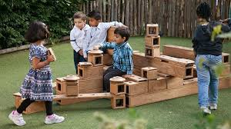
Maths in the Early Years
During Early Years children develop firm mathematical foundations in a way that is engaging, and appropriate for their age.
Children learn some key concepts through a range of experiences.
There are six key areas of early mathematics learning: Cardinality and Counting; Comparison; Composition; Pattern; Shape and space; Measures.
Notes:
C & C Understanding that the cardinal value of a number refers to the quantity, or ‘howmanyness’ of things it represents
Comparison Understanding that comparing numbers involves knowing which numbers are worth more or less than each other
Composition Understanding that one number can be made up from (composed from) two or more smaller numbers
Pattern Looking for and finding patterns helps children notice and understand mathematical relationships
Shape and Space Understanding what happens when shapes move, or combine with other shapes, helps develop wider mathematical thinking
Measures Comparing different aspects such as length, weight and volume, as a preliminary to using units to compare later

Slide 7
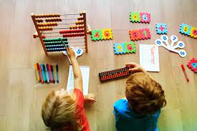
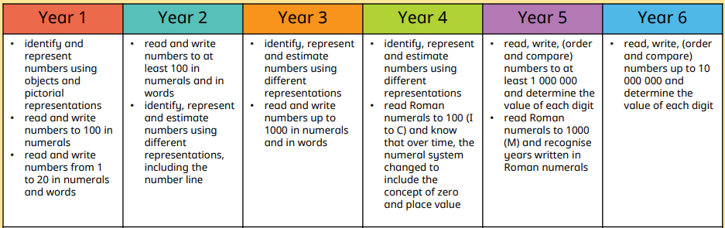
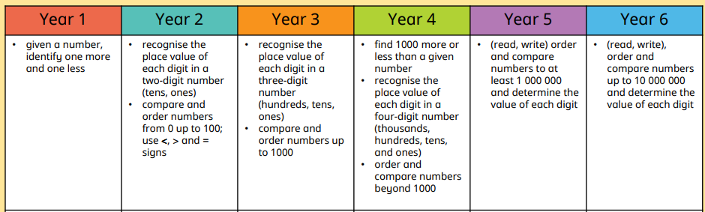
Progression Across
Year 1 – 6
Number

Slide 8
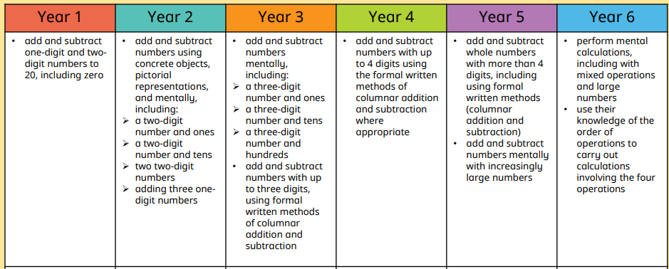
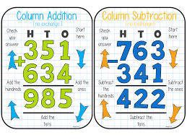
Progression Across
Year 1 – 6
Addition & Subtraction

Slide 9
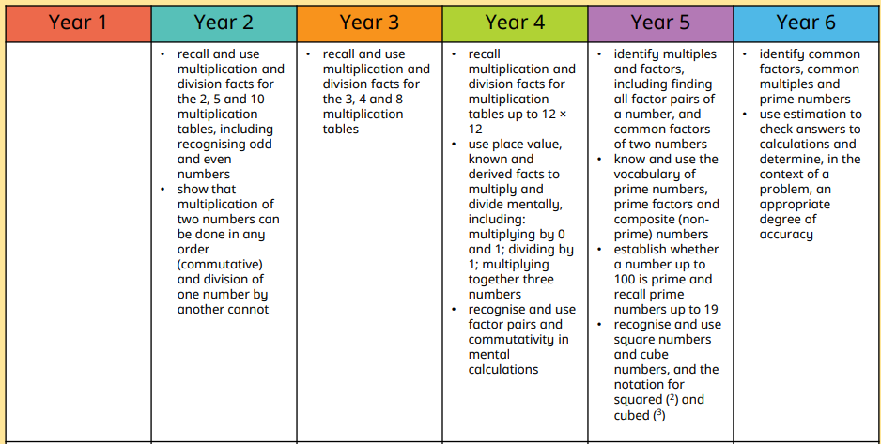
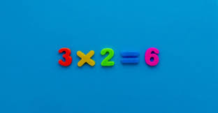
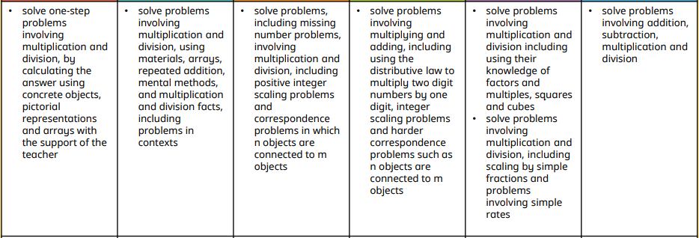
Progression Across
Year 1 – 6
Multiplication

Slide 10
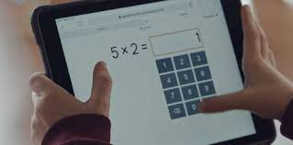
Assessments in Maths
Each year group will undergo their own assessments during each term in school. These help teachers to identify how confident children are in different areas of Maths.
In Year 2 and 6 children will undergo SATs testing.
In Year 4 children will complete the Multiplication Table Check (MTC) in the Summer term – it is an online activity where children will demonstrate their understanding of the times tables and related division up to 12x12.

Slide 11
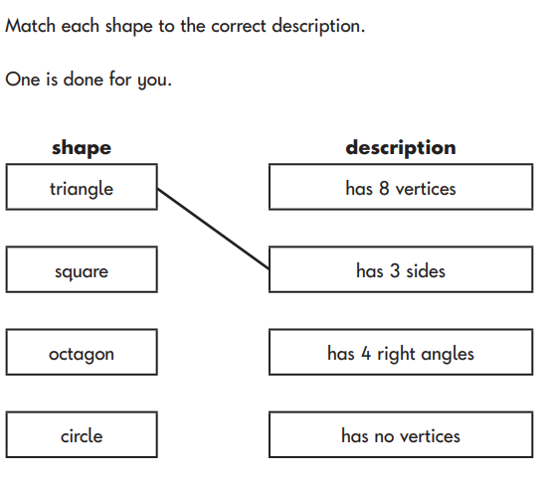
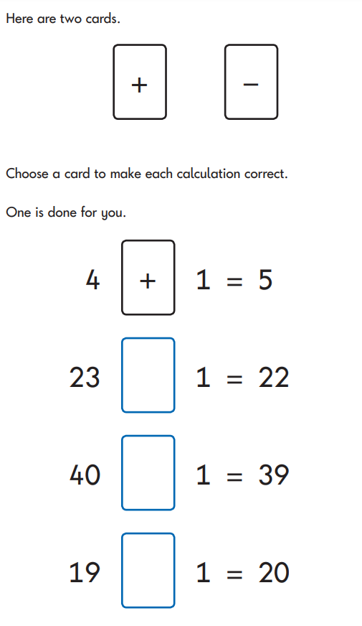
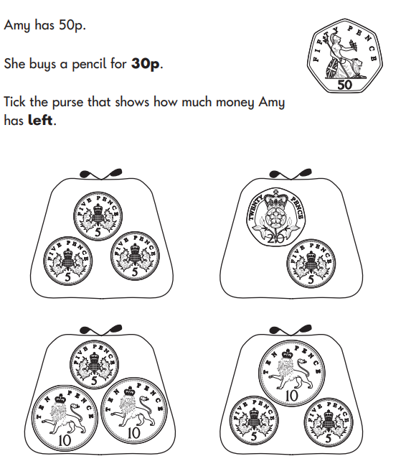
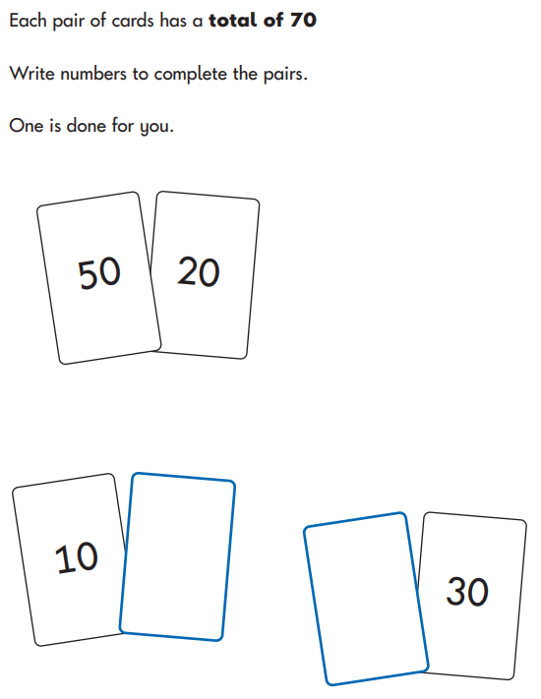
Year 2

Slide 12
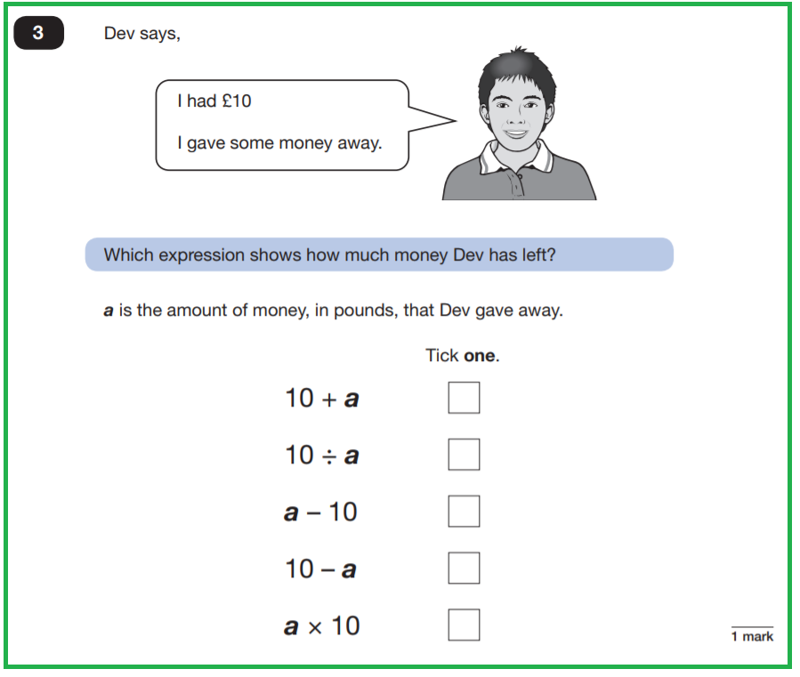
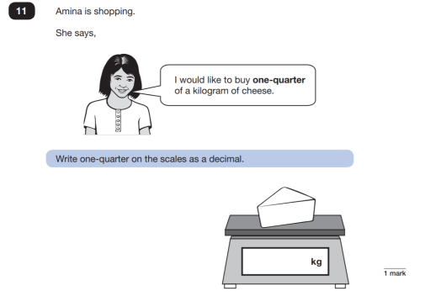
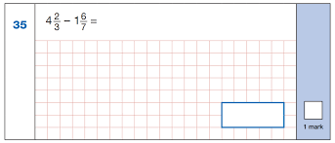
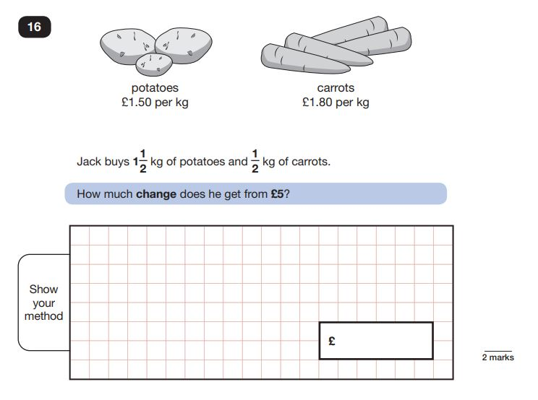
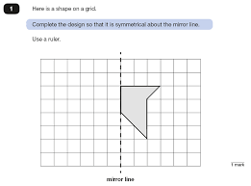
Year 6

Slide 13
Times Tables
1. Practise tables as a time-filler –
When you’re sitting at traffic lights or waiting in the doctor’s surgery it is the perfect opportunity for a bit of times table practice! It’s always better (for both your child and you!) to just spend a few minutes reciting or testing times tables rather than going into overdrive and spending too long practising them.
2. Help them with the ones they find tricky
There are usually one or two multiplication facts in each times table that are more difficult. When you notice that your child is stumbling over the same fact each time, try to give them extra practice. You could even get your child to write the fact out in a fun way on a piece of card and then stick it somewhere prominent (like on the fridge) so that they have an extra reminder!
3. Use a number grid
Printing off a simple 10 x 10 number grid can be a great way to demonstrate how times tables relate to number sequences. You can get your child to colour in multiples of different numbers on different number squares so that they can clearly see the number patterns.
4. Make it real
The danger with too much rote learning of times tables is that children can fail to see the use of times tables in real life. Try to take opportunities to get your child to use multiplication in problem solving, for example working out quantities for scaling up a recipe, or calculating the price of more than one item of shopping.
5. Create a challenge
Make it fun by turning times table practice into a competition or challenge for your child, by timing them and keeping a record of their scores. You could even join in yourself and set a challenge to learn a more difficult times table, such as the 13 times table and get your child to test you at the end of the week in exchange for testing them…
Learning times tables off by heart makes mental maths much easier. It will boost your child’s confidence in their maths lessons at school, but it’s also a skill they’ll use all the time in the world outside school.
Here are just a few examples of how to help your children at home…
Games (online), flashcards, songs

Slide 14

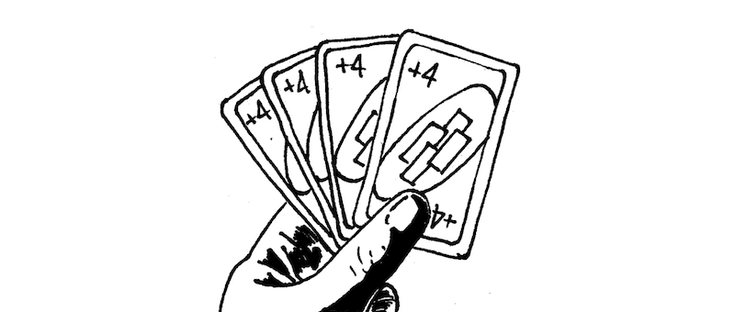
Helping Your Children at Home
Discuss Maths with your Child at Home
  How many is that? How many would I have if I had another one?
  What would half of that look like?
  How could I split this equally?
  What’s the chance of that happening?
  How many eggs would I need if I made double the amount in this recipe?
  How many cards will you draw?
Learn Maths Through Playing Games
Sing nursery rhymes / songs
Use Your Child's Interests to Help with Maths
See Maths in Everyday Life
  What shapes do you see around you?
  What is one / ten more than this number of cars/sweets/toys?
Involve your children in cooking or shopping
  Counting out money
  Estimating cost
  Estimating weight which is heaviest/lightest
  Weighing ingredients – reading scales
Notes:
Educational games include playing cars, playing with a tea set, building towers with Lego or similar toy bricks, or playing cool math games on a tablet.

Slide 15
Thank you so much for attending!
Any questions?

