Slide 1
Adaptations in KS1 and Year 3
16.10.25

Slide 2
What is adaptation?
Adaptation is strategies and modifications that teachers make to lessons and resources to accommodate the needs of all pupils in the class.
This can look different across different classrooms depending on the needs of the children.

Slide 3
Scaffolding
In writing, we may scaffold by giving sentence stems ( the beginnings of sentences) which the children then complete.
A template for children to fill in gaps.
The use of images and pictures to encourage detail.
Word banks to support spellings.
Partner work where ideas can be shared before writing.

Slide 4
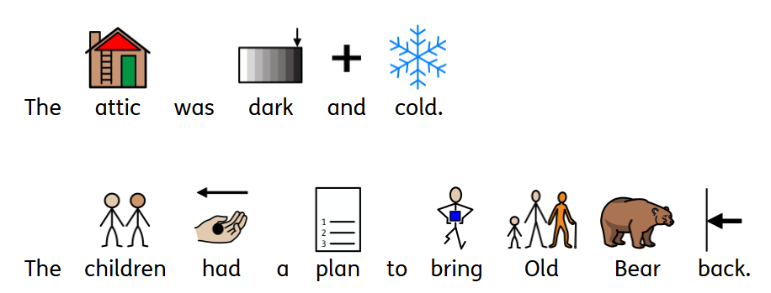
Widgits
These are simple, colourful drawn symbols to demonstrate a word clearly and concisely.
They are a versatile resource which is used for supporting communication.

Slide 5
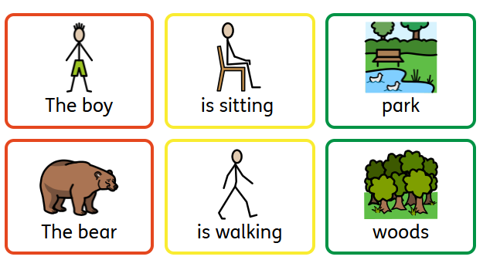
Colourful Semantics
Colourful semantics is a teaching approach that aims to help children to understand sentence construction, building sentences that use colour-coded visuals for different parts of a sentence.

