Slide 1


Welcome to our
Nutrition at Barford Workshop

Slide 2



Staff
Year 1 Holly
Contents of today:
The first part – food serving safety
The second part – Eat-Well guide
The third part – NHS advice on how to stop a child from choking.
The final part – Our policy at Barford and helpful resources

Slide 3

Staff
Year 1 Holly
The first part – food serving safety
Who is this publication for? It may be useful to share with parents and/or carers to help them with providing healthy, balanced and nutritious food.
For babies and young children, food can be a choking hazard, especially when they do not chew their food well or they try to swallow it whole.
Choking can happen with any foods, but ‘firm foods’, bones and small round foods that can easily get stuck in the throat present a higher risk.
Make sure that food is prepared appropriately to minimise any risk of choking. The Food Standards Agency has 2 posters on how to prepare food safely to avoid choking.

Slide 4
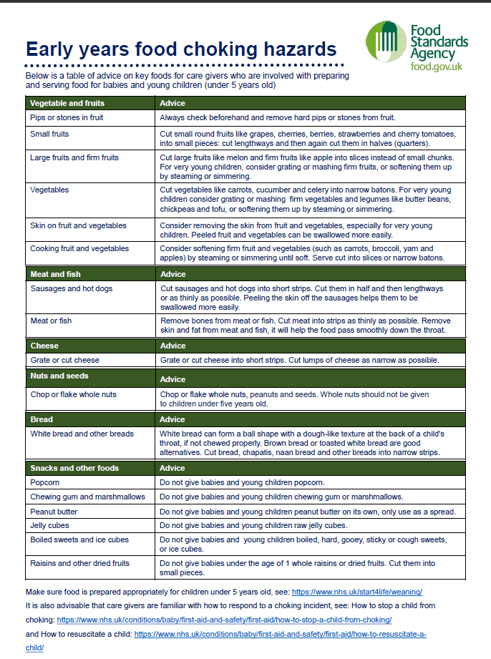
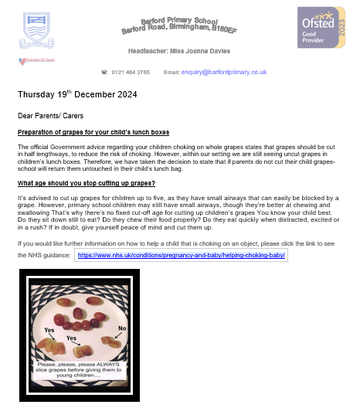
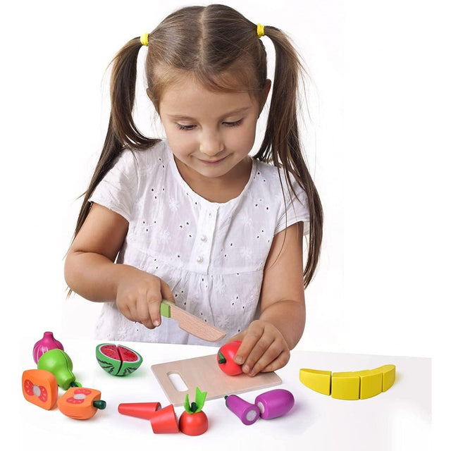
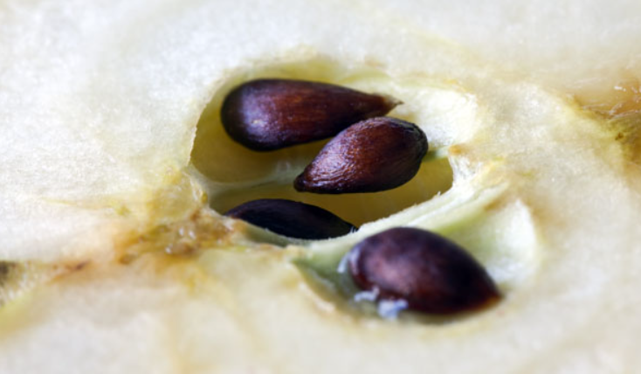
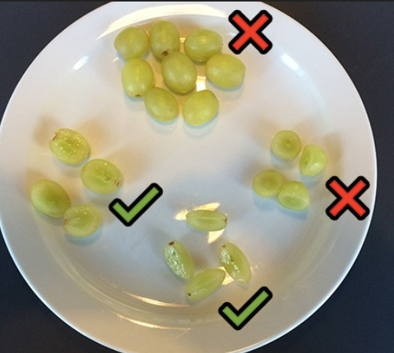
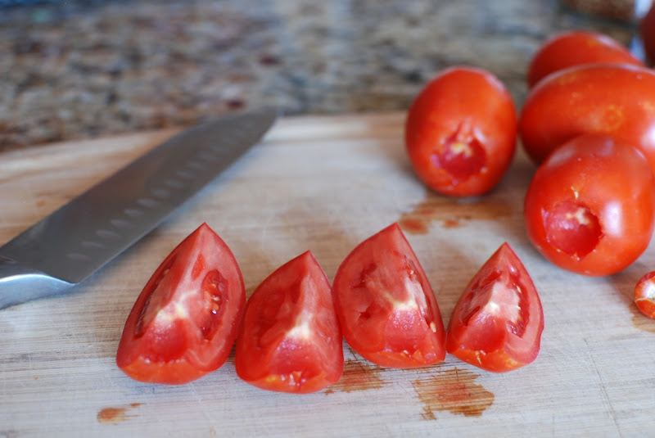
Staff
Year 1 Holly
The first part – food serving safety

Slide 5

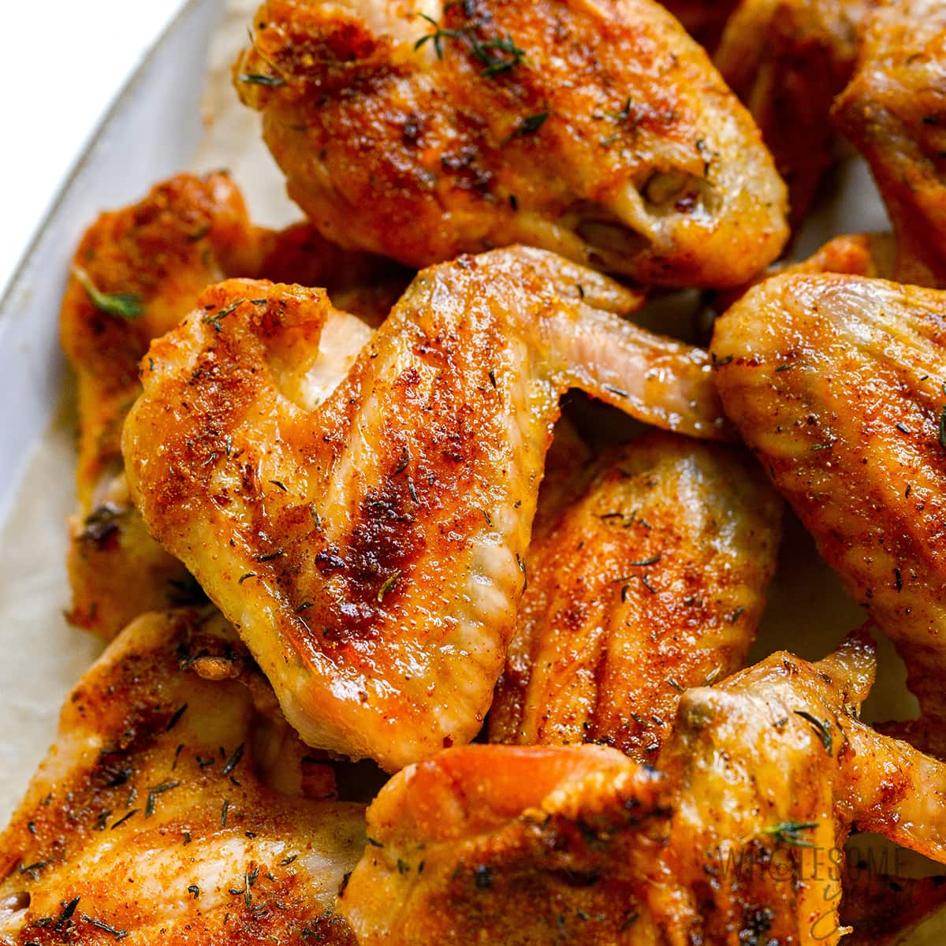
Staff
Year 1 Holly
The first part – food serving safety

Slide 6


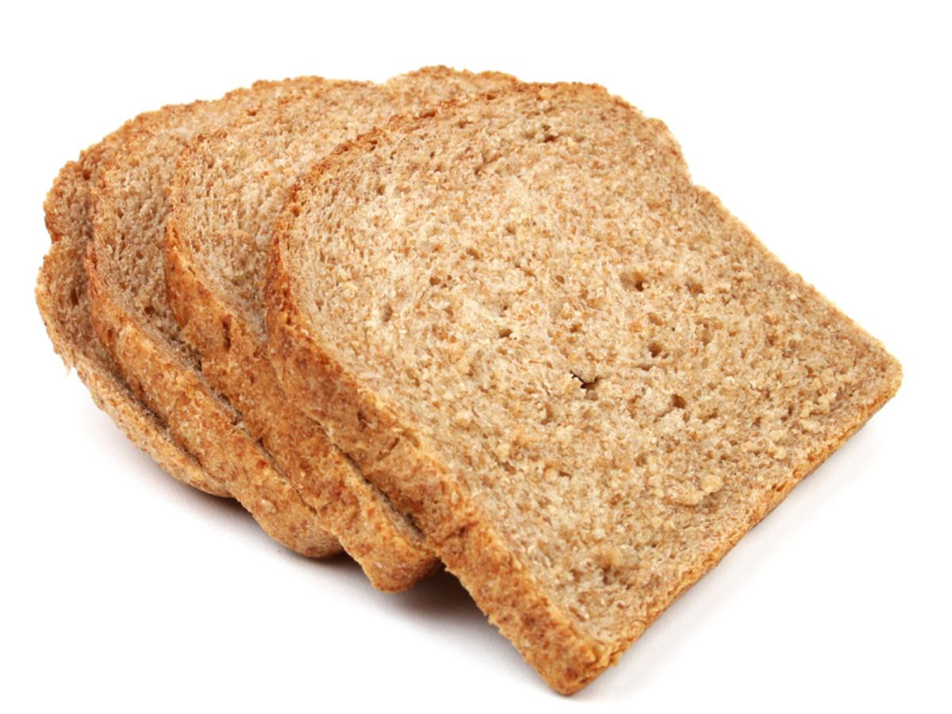
Staff
Year 1 Holly
The first part – food serving safety

Slide 7

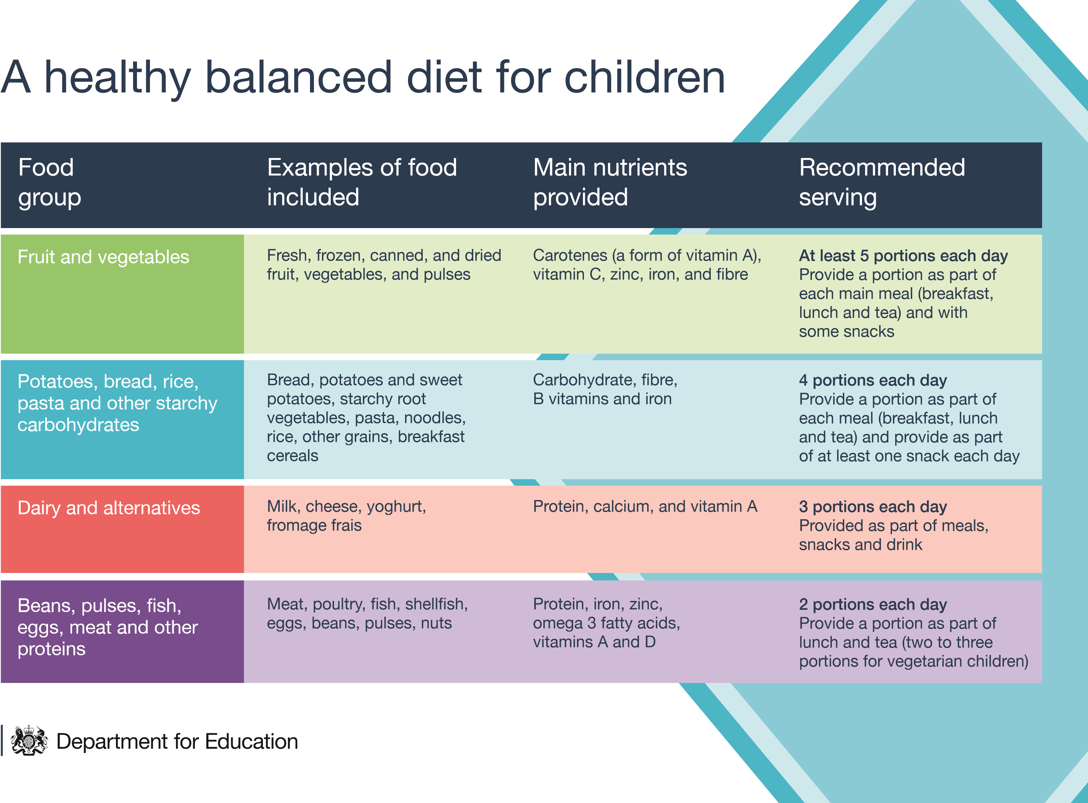
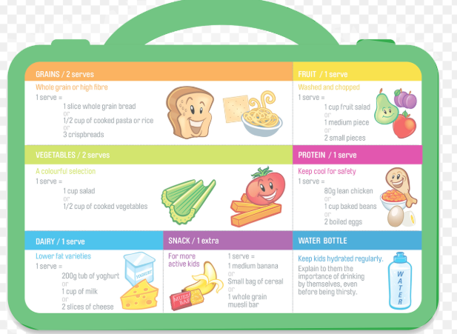
Staff
Year 1 Holly
The second part – Eat-Well guide

Slide 8
Staff
Year 1 Holly
The third part – NHS advice on how to stop a child from choking.
How to stop a child from choking - NHS
Tips on helping a choking child
If you can see the object, try to remove it. Don't poke blindly or repeatedly with your fingers. You could make things worse by pushing the object further in and making it harder to remove.
If your child's coughing loudly, encourage them to carry on coughing to bring up what they're choking on and don't leave them.
If your child's coughing isn't effective (it's silent or they can't breathe in properly), shout for help immediately and decide whether they're still conscious.
If your child's still conscious, but they're either not coughing or their coughing isn't effective, use back blows or chest thrusts (babies under 1 year), or back blows or abdominal thrusts (children over 1 year).
You may need to use more than 1 method to stop choking. It doesn’t matter which order you do them in. If one method doesn’t work, try the other method. Keep trying each method until the object comes out.

Slide 9
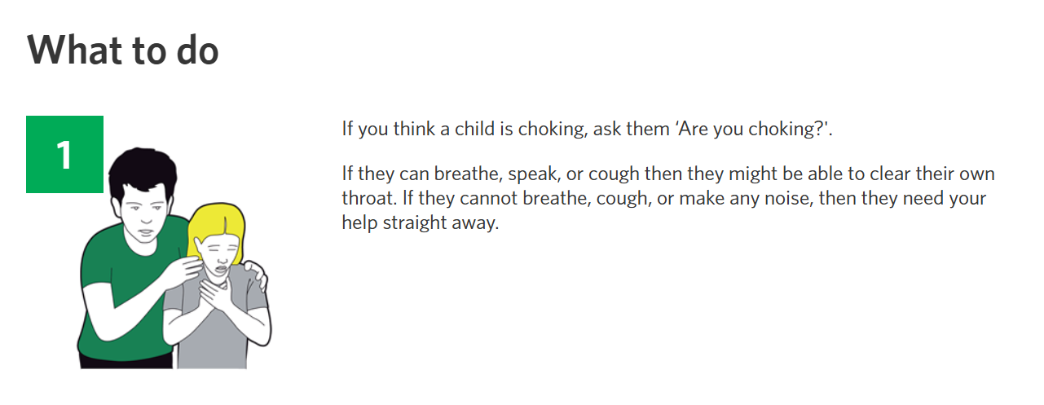
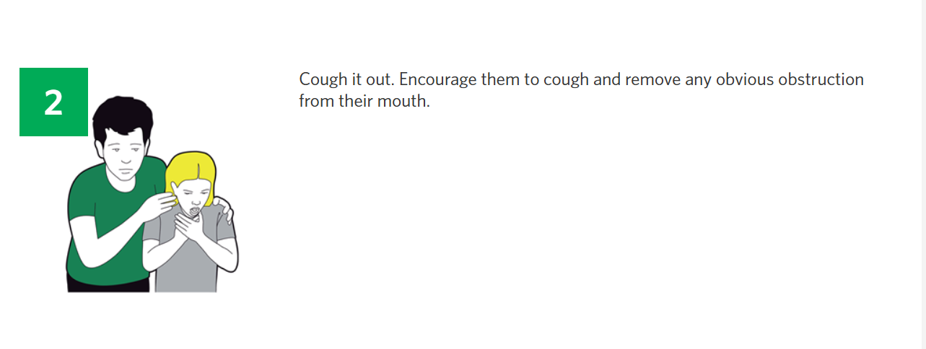
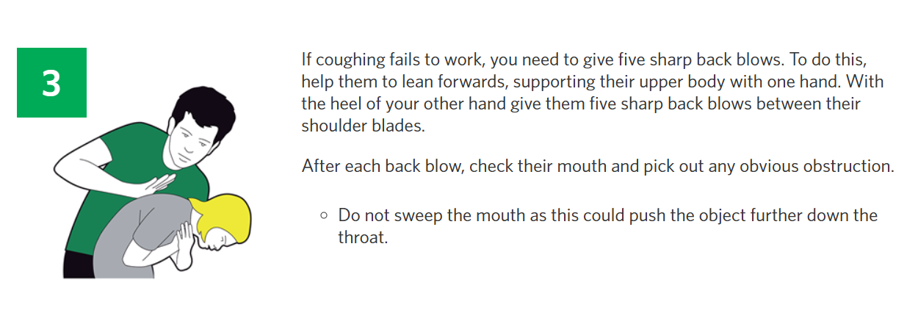
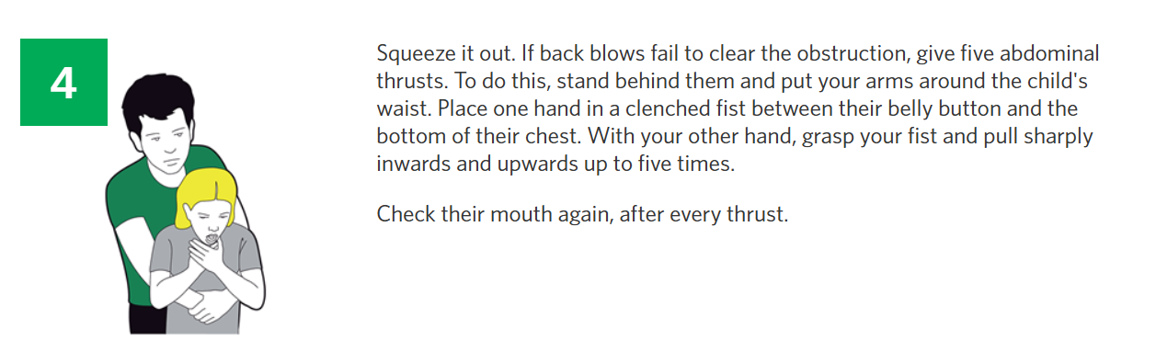
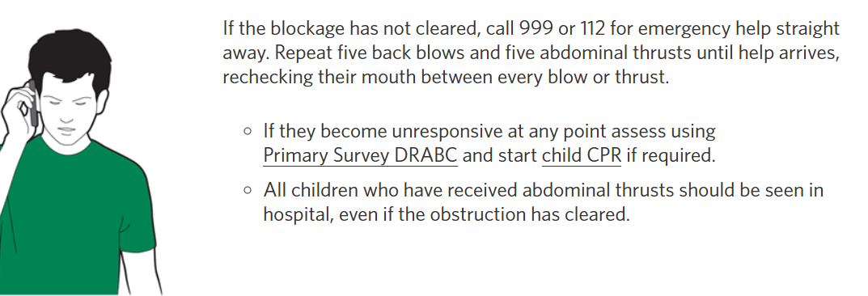
Staff
Year 1 Holly
The third part – further advice

Slide 10
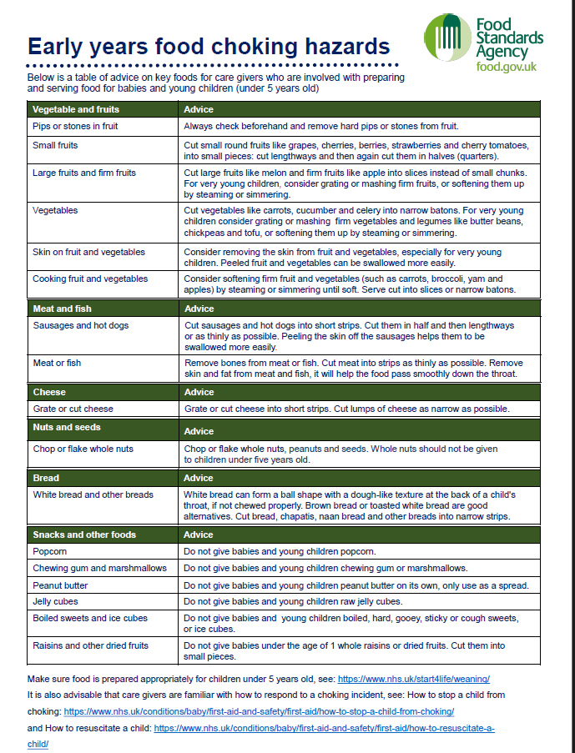

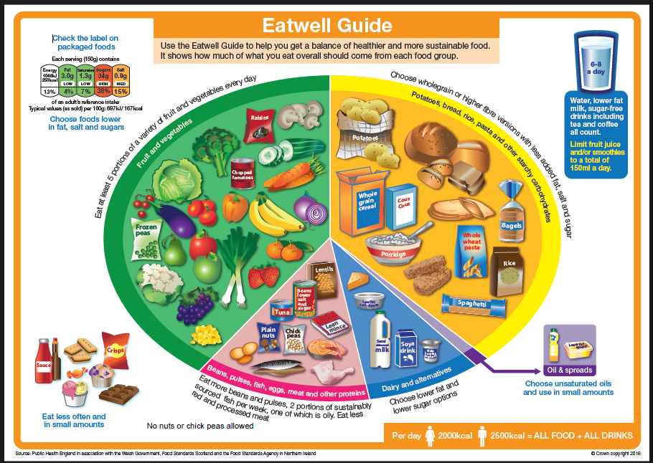
Staff
Year 1 Holly
The final part– Our policy at Barford and useful resources

