Slide 1


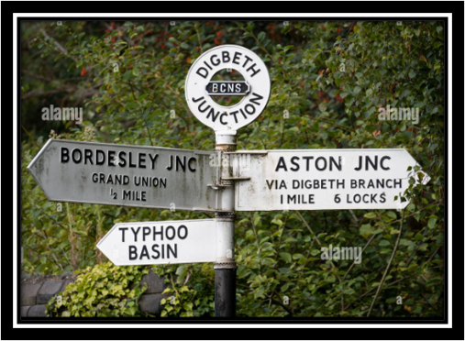

Editing at Barford

Slide 2
What is editing?
When you edit your own writing, you make changes, correct mistakes and make it even better.
You should never be afraid to make mistakes when you are writing. Checking, correcting and changing your work means you are on your way to producing something really great!

Slide 3
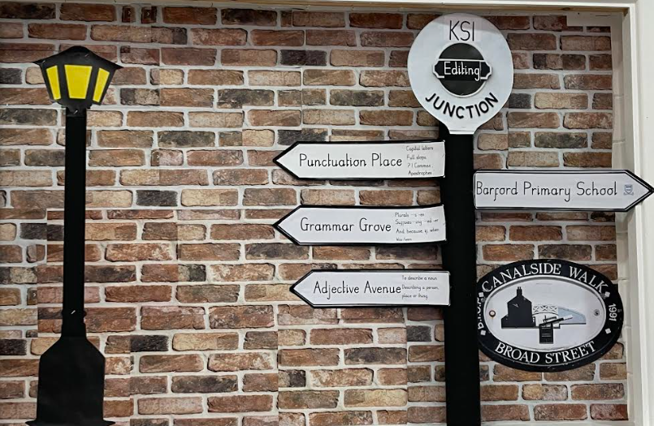
What are the different junctions in Barford Primary School?
These junctions are based on the Birmingham canal signs.
There are three junctions
These are as follows:
1. Punctuation Place.
2. Grammar Grove.
3. Adjective Avenue.

Slide 4
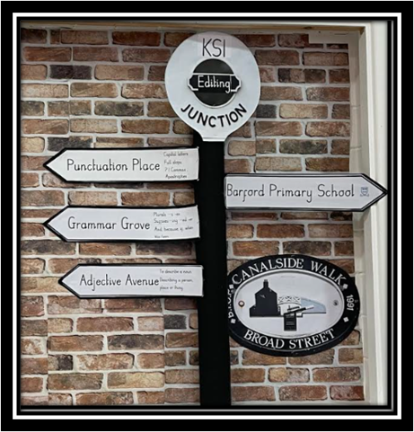
Editing in KS1
Throughout the academic year, KS1 will focus on the following using weekly discreet lessons throughout the academic year:
1. Punctuation Place (Autumn Term)
Capital letters​
Full stops​
? 1
Commas in a list (Year 2)
Apostrophes (Year 2)
2. Grammar Grove (Spring Term)
Plurals (-s –es) ​
Prefixes –un and Suffixes –ing –ed –er​
Conjunctions ‘and’, ‘because’, ‘but’
3. Ajective Avenue (Summer Term)
To describe a noun. Describing a person, place or thing.

Slide 5
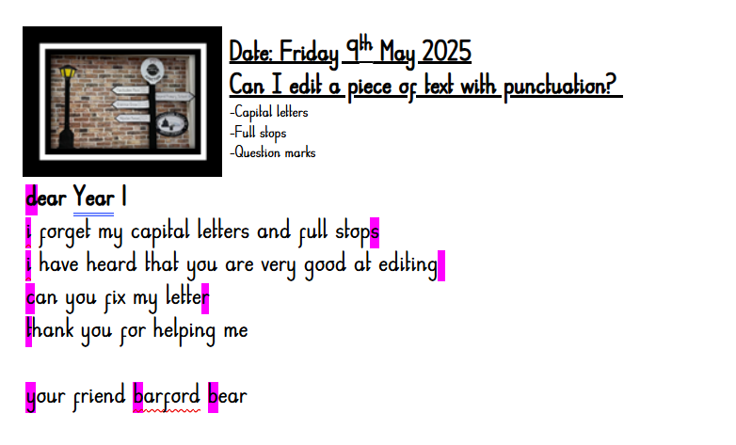
Editing in KS1

Slide 6
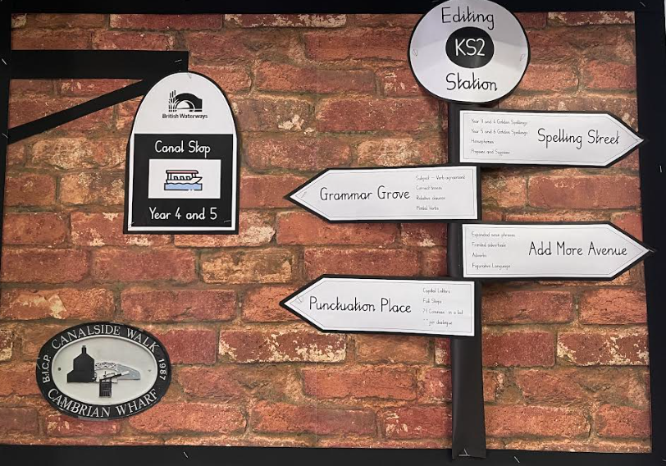
Editing in KS2
Children in KS2 will continue to embed and build on what was taught in KS1 but will move onto further junctions throughout the academic year in line with the NC expectations. These are as follows:
1. Spelling Street
- Year ¾ 5/6 golden spellings.
-Homophones
-Prefixes and suffixes.
2. Grammar grove
-Subject – verb agreement
-correct tenses
-Relative clauses
-Modal verbs
3. Add More Avenue
-Fronted adverbials
-Figurative language.
4. Punctuation Place
-Commas in a list
-Inverted commas for dialogue

Slide 7
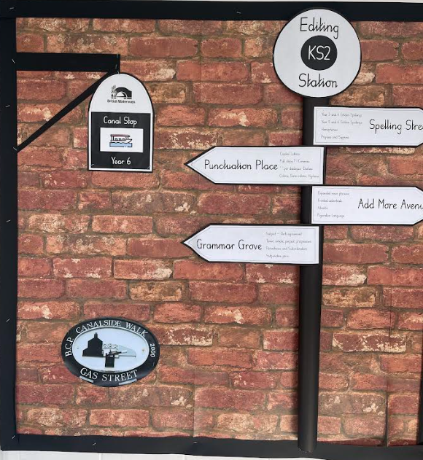
Editing in Year 6
Year 6 will continue to consolidate and refine what has been taught so far. They will ensure that the foundations are in place ready for the KS2 SATS papers including capital letters and full stops. They will focus on subjunctive forms in addition to using a full range of semi colons.

Slide 8
How can you help at home?
Step 1.
Re-read what has been written.
Step 2:
Highlight any errors in punctuation first and foremost. Don’t tell your child what is missing. Let them try to think for themselves.
Step 3:
Let them correct it above the word or at the end of the sentence.

