Slide 1
Behaviours and Attitudes
Parent Workshop
Barford Primary School

Slide 2
Behaviour and Attitudes
Attendance
Behaviour
Respect
Attitude to learning

Slide 3
Why we are clear in our expectation of our children’s behaviour
We want to make sure that :
We are setting each and every child up for success
Every child knows what we expect of them
Every child gets the most out of their learning

Slide 4
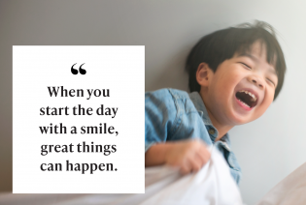
Notes:
How each one of us (school staff) welcomes children each morning matters !

Slide 5
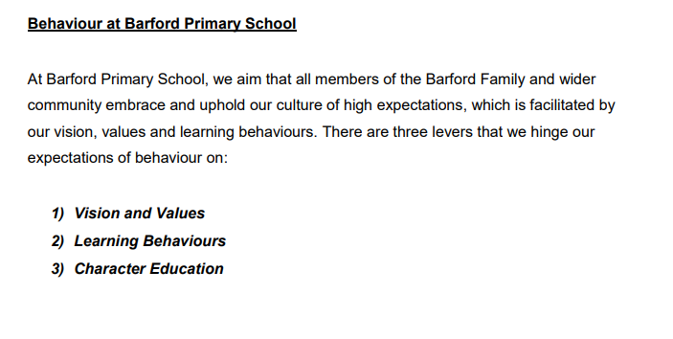

Slide 6
Our School Vision
At Barford, our unique children and staff feel safe, valued and respected in an emotionally secure environment. The Barford family is resilient, confident and caring. We provide opportunities and experiences to help us strive, thrive and fulfil our full potential in all that we do. Barford is place where we feel nurtured and given ‘wings’ to fly!
Created by staff & parents

Slide 7
Children’s vision
At Barford Primary School, we believe in ourselves. We want everyone to be included and we are always kind and welcoming. Through lots of different exciting educational activities, experiences, visitors and trips, we gain lots of knowledge and skills. We work and learn as a team (children, adults and our community) to make sure we are successful and we help create bright futures for ourselves. We work with our trusted adults, each other and our community to keep everyone safe and successful.
Created by School Council

Slide 8
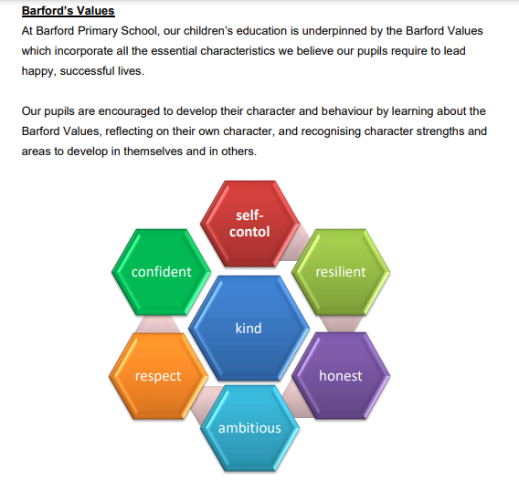
Barford’s Values
At Barford Primary School, our children’s education
is underpinned by the Barford Values which
incorporate all the essential characteristics we
believe our pupils require to lead happy, successful
lives.

Slide 9

Lever Two - Learning Behaviours
To be a successful learner, children need to develop key aptitudes that will enable them to access all their learning to the fullest extent. Our five key behaviours develop skills and attitudes to learning that put our children in good stead for the challenges they will meet throughout their lives. We are helping to build successful futures for all our children by showing them how to be highly motivated learners. Adults are expected to nurture these behaviours

Slide 10
Lever Three - Character Education
Character education at Barford is built into the curriculum (as taught components) as well as outside of it.
The ‘taught’ character curriculum:
The school uses the Jigsaw scheme to support children’s development in PHSE.
Jigsaw PSHE connects the pieces of Personal, Social, Health and WellBeing Education. The programme teaches children and young people emotional literacy, social- and lifelong skills, RSE/RSHE and resilience in an age-appropriate manner.
Enrichment activities that include trips and visits, non- curricular courses or workshops.
Extra-curricular programme (e.g. before- and after-school clubs)

Slide 11

Rewarding Good Behaviours

Slide 12
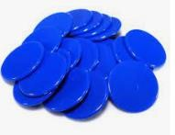
School behaviour systems, structures and routines
House Points
All children in the school are allocated a place in one of the four houses
Mars, Jupitar, Saturn and Venus.
When adults see children demonstrating one of the Barford Values, they will reward them with a blue house point token. Each class has a set of house point collection boxes where children deposit their token. House point monitors collect all the tokens once a week and add them to the large house point display in the main hall. Tokens winners are announced each Friday in the celebration assemblies. Children can also earn special green lunchtime house point tokens (see rewarding lunchtime behaviour for more details).

Slide 13

In class the children can earn Dojo points as a reward for using one of the school’s learning behaviours. This is a purely a positive recognition strategy.
Dojo points are cumulative and are collected across the week. Two children with the highest number of Dojo points in each class are invited to choose a prize from the Dojo prize cupboard (run by children).

Slide 14

Use of the Great to be Gold Board
All classes from Early Years to Year 6 use the Great to Gold Board!
Every child starts the day on green.
Children can be moved up into silver and gold for showing excellent classroom behaviours.
If child reaches gold at either the end of a morning or end of the day- they will receive a gold sticker. The teacher will record this on SLEUTH and speak to the parent (on that day) to share the good news.

Slide 15

Celebration Assemblies

Slide 16
Sanctions
When low-level behaviour is unacceptable and disrupting learning

Slide 17
Coaching and supporting children
Aim - Child returns to learning and staff focus on the positive behaviour being displayed.
The adult will give expectation reminder
Explain expected behaviour
Double checks for emotional / understanding issues.
Adult must give the child take up time and strategies.
The adults to use a range of strategies to de-escalate behaviour that are appropriate for the age of the child.
The adult scaffolds a short reflect time and models expectations for the child's behaviour.
Child returns to learning and staff focus on the positive behaviour being displayed.

Slide 18
We place a huge emphasis on the importance of learning.
We always tackle any disruption to learning quickly and effectively.
We want to help children make lasting changes to the choices they make.
When we see behaviour disrupting the learning:
EYFS - 1 minute =1 minute
Key Stage 1 &2 - 1 minute = 5 minutes
This has had a very positive impact in reducing disruptive behaviours in the classrooms.

Slide 19
Our Key Unacceptable Behaviours
These are behaviours which have consequences beyond the Great to be Gold Board.
Running away from staff or entering a non-safe zone
Sustained non-compliance
Deliberate physical violence towards staff, pupils or property
Persistent disruption and refusal to follow adult instructions
Racist or Homophobic behaviours, language or taunts
Swearing

Slide 20
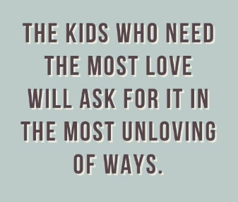
Pastoral Support Plans
3 levels
Important that parents, child and school work together to turn behaviour around
Target card
Daily communication between home and school (partnership)
Weekly meetings
Outside agency support

Slide 21


