Slide 1


Slide 2
Keeping Good Attendance !
Attending school regularly and on time has a very positive impact on the academic achievement and well-being.
We understand that at times your child may be unwell and unable to attend school, therefore our attendance target is 97%.

Slide 3
Research shows that excellent attendance & punctuality are important factors in achieving school success, therefore our aim is to work with parents to ensure the highest possible attendance for each pupil.
90% attendance may sound good but it means a child is could miss the equivalent of a whole year from school by the time they complete their education.

Slide 4
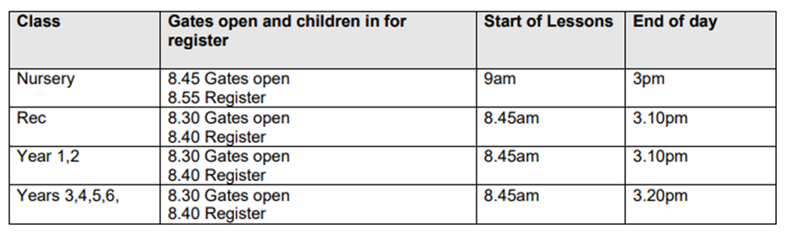
It’s essential that your child arrives promptly at school because the day starts off with the teacher explaining the day’s learning to the class.
Year 6 start 8.15am
Any child arriving after class registration at will be recorded as arriving late.

Slide 5
OFSTED November 2023
The school carefully checks pupils’ attendance and works effectively with families to improve attendance.
However, too many pupils arrive late to school and, therefore, miss important learning.

Slide 6
OFSTED TARGET
Too many pupils arrive late to school. This means that some pupils miss vital learning at the start of the day. The school should continue to support and challenge families, so that pupils’ punctuality improves.
Legal requirement for children to be in school at the set times.
Talk to us – Class teacher (book an appointment)
Inclusion Team support
Signposting support
Support with parent self referrals
Breakfast club spaces
SARM (School Attendance Review Meeting) Regular meetings to keep things on track

Slide 7

As your child’s attendance is very important to them succeeding at Barford Primary School and the school work with closely with a company called ‘SOL Attendance ’.

Slide 8
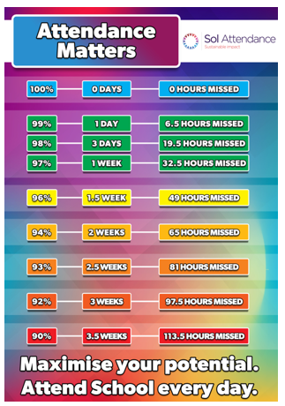

Slide 10
Systems and procedures to support attendance:
Introduction of the ‘SOL’ attendance tracker to store and monitor data regarding attendance and punctuality
Systems in place to contact parents and carers to monitor pupils’ punctuality or attendance
Dedicated member of staff (Attendance Officer) will monitor punctuality and attendance and follow-up with individual families
Pupils will be made aware of their weekly % attendance rate.

Slide 11
Where appropriate, attendance targets will be set (with parents) and made available across the School, so that pastoral, academic and support staff, are aware of an individual’s attendance as well as other learning targets
Attendance expectations will be made clear to parents and carers, including procedures for authorised absences and holidays and any action the School may take, including legal action, where attendance is an on-going concern.
Barford Primary School is committed to further continuous improvement in a holistic approach to attendance that engages pupils in their learning and provides programmes of study appropriate.

Slide 12

At Barford Primary School we have a system that rewards:
children's good attendance
97%-100%
2) celebrates weekly improvements in children's attendance.

Slide 13
The Golden Arrow
97-100%
Mariam
Simon
Aisha
3
week
2
week
1
week
Michael
Ben
Rehana
Hassan
Sally

Slide 14


The Golden Arrow
97-100%
3
week
2
week
1
week

Slide 15
Attendance Prize Cupboard

Slide 16


