Slide 1

Welcome to CUSP History
How we teach history at school
Helping children understand the past
Notes:
Welcome everyone and thank you for coming. Today I will explain how we teach history using the CUSP curriculum. CUSP stands for Curriculum with Unity Schools Partnership. It is designed to help children build a strong understanding of the past step by step. Our goal is for children to remember important knowledge, make connections between different time periods, and develop a real curiosity about history.

Slide 2
History Starts in Early Years
Children explore:
Past and present
Change over time
People’s lives through stories and visitors
Their own experiences
Notes:
History learning begins in the Early Years. Children start to notice the difference between the past and present. They explore how things change over time through everyday experiences, stories, and discussions. They also learn about the lives of others through books, visitors, and family experiences. These early experiences form the foundation for future history learning.

Slide 3
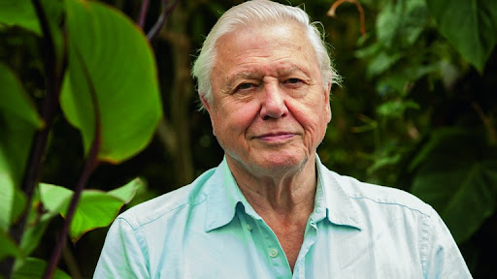
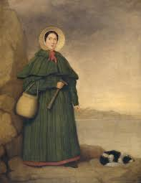
Building on Learning in Key Stage 1
Children begin to:
Learn about important people
Explore events in the past
Start building a timeline

Slide 4
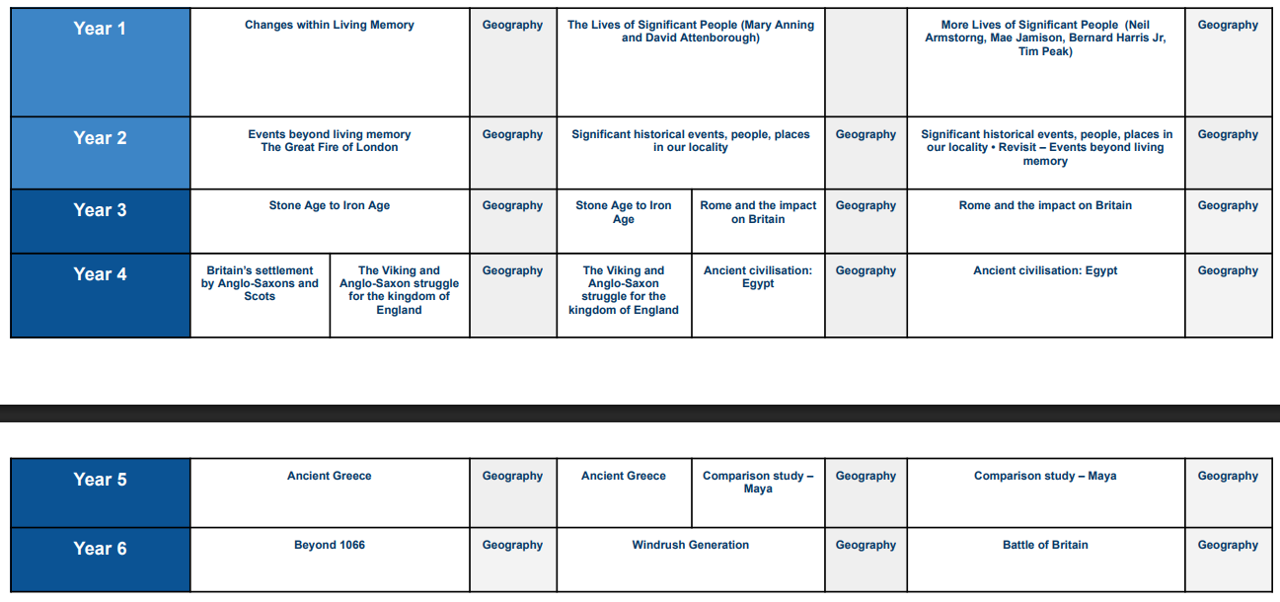
Learning Through Connections
Notes:
CUSP History is carefully designed so that children connect new learning to what they already know. They learn about the order of events in history, why things happened, and how societies changed over time. This helps children develop a deeper understanding rather than just remembering isolated facts.

Slide 5
Helping Knowledge Stick
We help children remember learning through:
Retrieval practice
Spaced learning
Repetition and practice
Vocabulary development
Notes:
A key part of the CUSP curriculum is helping knowledge stay in children’s long-term memory. Teachers regularly revisit previous learning through retrieval practice and spaced learning. This means children recall information they have learned before, which strengthens their memory and understanding.

Slide 6
Developing Historical Vocabulary
Children learn:
Everyday academic words (Tier 2)
Subject specific history words (Tier 3)
New vocabulary in every unit
Notes:
Vocabulary is a really important part of learning history. Children learn general academic words that help them explain ideas, as well as subject-specific historical vocabulary. Each history topic includes planned vocabulary teaching so children can speak and write about history clearly.

Slide 7
Becoming History Experts
Each topic:
Revisits important ideas
Builds deeper understanding
Expands the timeline of knowledge
Notes:
Throughout primary school, children revisit important historical ideas and themes. Each new topic builds on previous learning and becomes slightly more complex. Over time, children develop a broad and connected timeline of history in their minds.

Slide 8
A Curriculum With No Ceiling
We believe:
All children can learn powerful knowledge
Curiosity about the past should grow each year
History should be meaningful and memorable
Notes:
At our school we believe there is no ceiling to what children can learn. By carefully structuring the curriculum and using evidence-based teaching methods, we help every child build powerful historical knowledge and develop a lifelong interest in the past.

Slide 9
Thank You
Questions and discussion
Notes:
Thank you for listening. I hope this has helped you understand how we teach history through the CUSP curriculum. We would now be happy to answer any questions you may have.

