Slide 1
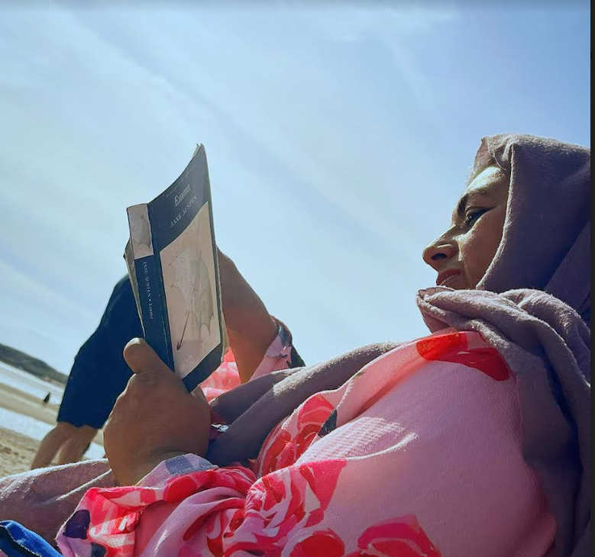
Reading at Barford
Reading - Changes lives…

Slide 2
Aims
To explain why Reading is so important.
To provide you with an overview of how we teach reading in school.
To introduce you to Accelerated Reader.
How can you support children at home?

Slide 3
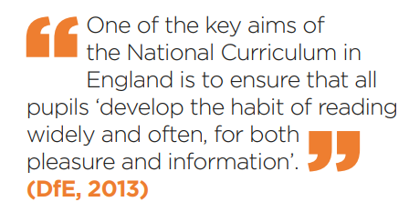

Slide 4




How many times have you already read today?
Notes:
Slide purpose:
To help parents see the value of reading by getting them to reflect on their own reading experiences
Suggested script:
Just think about how many times you have already read things today. More than ever, we are surrounded by text and reading is a vital skill.
We want all of our children to become confident readers who can navigate the world of reading around them.

Slide 5
How the teaching of Reading progresses in school.
What we use to Teach reading? | How we build skills?
Nursery - Little Wandle Foundations for phonics | Learning the ‘phonic code’ Sounding and blending to read. Developing fluency Developing prosody (expression|) Comprehension
Reception - Little Wandle Letters and Sounds Revised phonics programme.
Year 1 - Little Wandle Letters and Sounds Revised Phonics programme.
Year 2 - Little Wandle phonics into Little Wandle Fluency programme | Children become fluent readers.
Year 3 - Year 6 - Reading skills developed using ‘Steps to Read’ | Increasing range of reading skills understanding/interpreting/analysing a range of texts.

Slide 6

Little Wandle
Visit our website for more information for parents

Slide 7

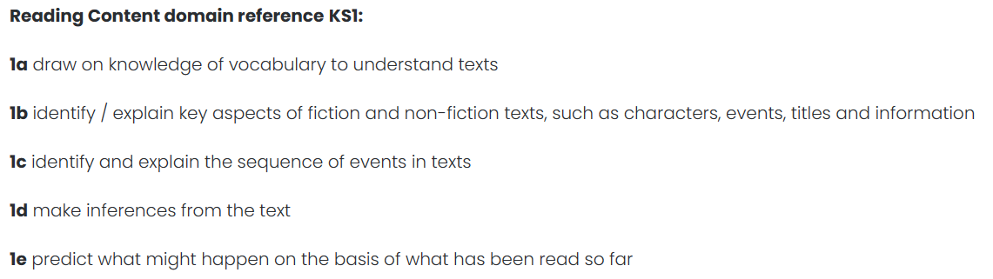
Developing Reading Skills - KS1

Slide 8
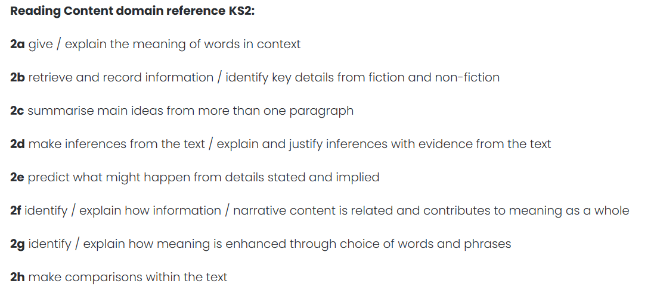
Developing Reading Skills - KS2

Slide 9
Accelerated Reader at Barford
Reading as a way of life…

Slide 10
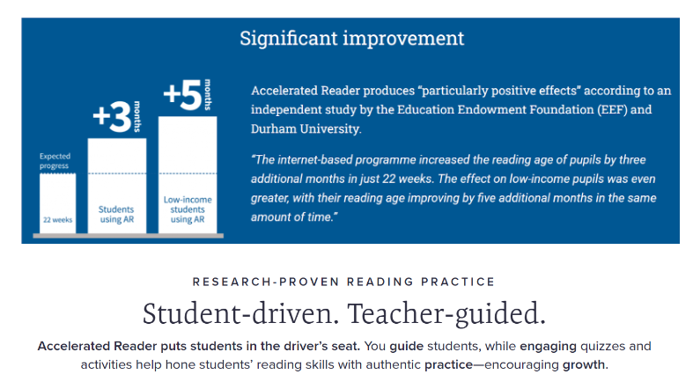
Why Accelerated Reader?

Slide 11
How it works?
1. We have assessed all children to establish their reading ability. Based on this children have chosen books to take home.
2. Read books and pass quizzes (85%+) so that overtime their reading ability improves.
3. We will use the assessment to track children's progress termly and take action to support children where that is needed.
Each book has a label - this gives you a Book Level & a points value for passing the quiz.

Slide 12
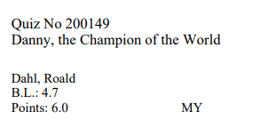
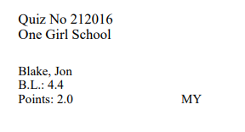
How it works?
Each book has a label - this gives you a Book Level & a points value if the quiz is passed.

Slide 13
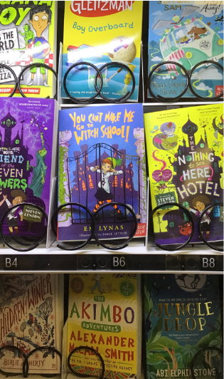
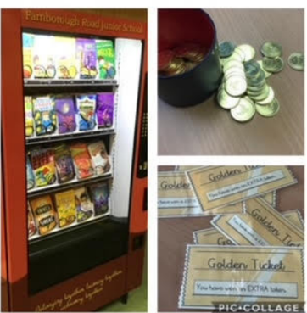
Children earn free books as a reward.

Slide 14
Rewarding reading success
So what do you have to do to get a free book?
Two ways:
Score 100% in 2 consecutive quizzes.
Reach 10 points from completing quizzes.
If you do either of these you will receive a token to use in the vending machine.

Slide 15
Supporting children’s reading at home
Listen to children read and read to your children.
Talk to children about their reading.
Make sure children bring their books into school, every day.
Encourage them to read a variety of things – read, read, read!

